Slide 1
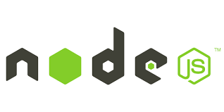
The Server-side JavaScript

Slide 2
MEAN STACK – FULL STACK DEVELOPMENT
Angular : It is a UI development part. It is the front-end framework that runs the code in the browser.
NodeJS: It is the runtime system that implements JavaScript(js) on the back-end web application. It is a runtime environment capable of running JavaScript on a machine.
ExpressJS: It is the back-end application that runs on top of NodeJS. It is a layered framework built on top of NodeJS that takes care of the website’s back-end functionality and structure.
MongoDB: It is used to store the data of back-end applications as JSON files. It is a document-oriented No-SQL data store.

Slide 3
MERN STACK – FULL STACK DEVELOPMENT
ReactJS : It is a UI development part. It is a library that facilitates creating the UI components of single-page web applications.
NodeJS: It is the runtime system that implements JavaScript(js) on the back-end web application. It is a runtime environment capable of running JavaScript on a machine.
ExpressJS: It is the back-end application that runs on top of NodeJS. It is a layered framework built on top of NodeJS that takes care of the website’s back-end functionality and structure.
MongoDB: It is used to store the data of back-end applications as JSON files. It is a document-oriented No-SQL data store.

Slide 4
History - NodeJS Application
Created by Ryan Dahl, first 2009 for only Linux.
Sponsored by Joyent.
June 2011, Microsoft partnered with Joyent to help create a native Windows version of Node.js.

Slide 5
Introduction to Node.JS
V8 is an open source JavaScript engine developed by Google. Its written in C++ and used in Google chrome browser.
Node.js run on V8.
Official Website for NodeJS Application -
https://nodejs.org
Open source & cross-platform project-It run on Linux Systems and also run on Windows Systems.
Node.js = Runtime Environment + JavaScript Library

Slide 6
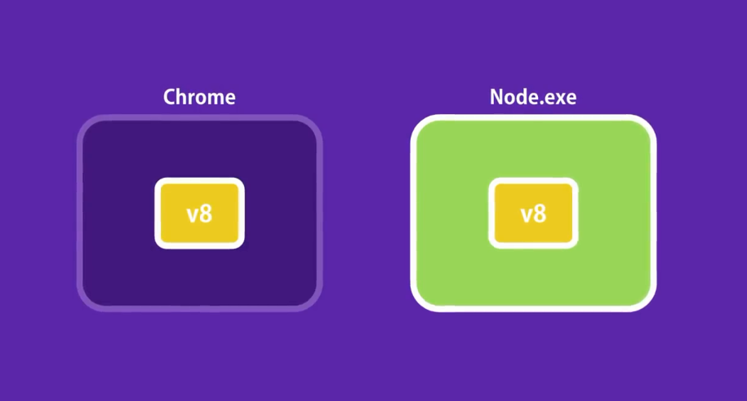
NodeJS App - Introduction

Slide 7
Software required for Full Stack using MERN STACK !!
Node.js platform (The Node.js binary installable)
npm (Node Package Manager) or npx or nvm
MongoDB and MongoDB Compass
Visual Studio Code (IDE) or Notepad / Notepad++ (Text editor) or Sublime Text.

Slide 8
Some Characteristics of NodeJS
Build on Chrome's JavaScript runtime environment.
Event driven & Non-blocking IO(by calling callback function).
Real time apps.
Single threaded.
Build in Async IO, HTTP/s, file-system etc.
Ability to run JavaScript on out-side of a browser(that means on server).
Act as a web server

Slide 9
Some points about Node.js
In simple word node.js is “server-side JavaScript platform”
It’s a command line tool (CLI based )
In “node.js” where “js” doesn’t mean that its solely written in JavaScript.
It’s 40% “js” and 60% “c++”.

Slide 10
Continue…
node js uses an event-driven,non-blocking i/o model which makes it lightweight.
Program for node.js is written in javascript and extension of a nodejs file is .js but it’s not the same javascript which we are use to, because there is no document Object Model(DOM) implementation provided by Node.js
Example: The below mentioned statement is not valid for NodeJS Application:-
document.getElementById(“elementId”);

Slide 11
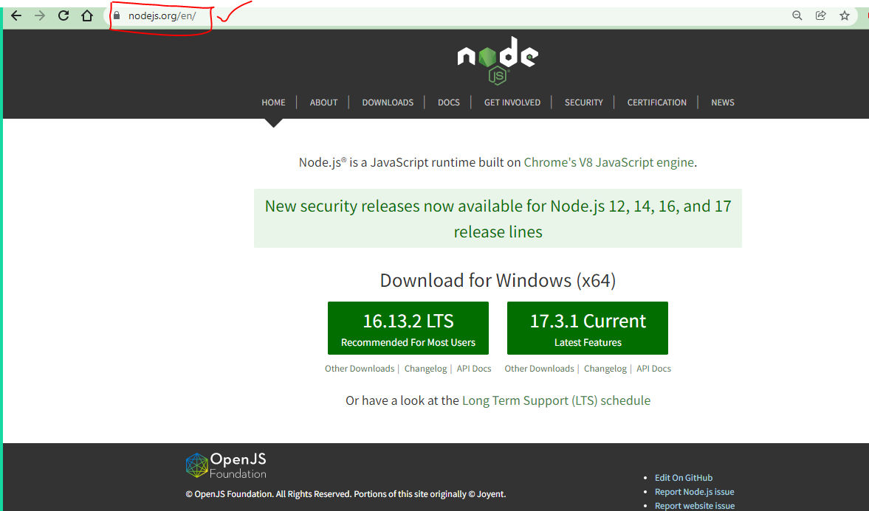
How to download and install Node.js
Download link :
https://nodejs.org/en/

Slide 12
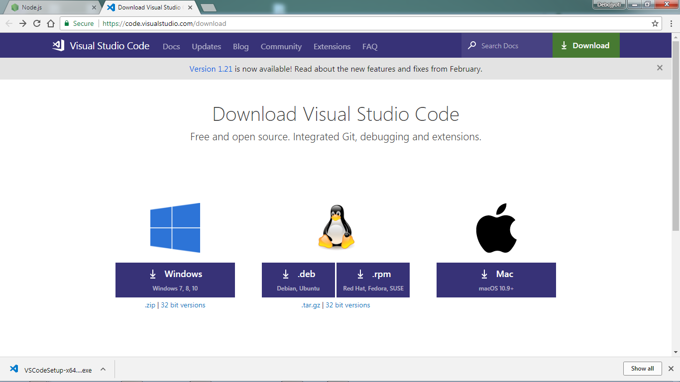
How to download and install VS code
Download link :
https://code.visualstudio.com/download

Slide 13
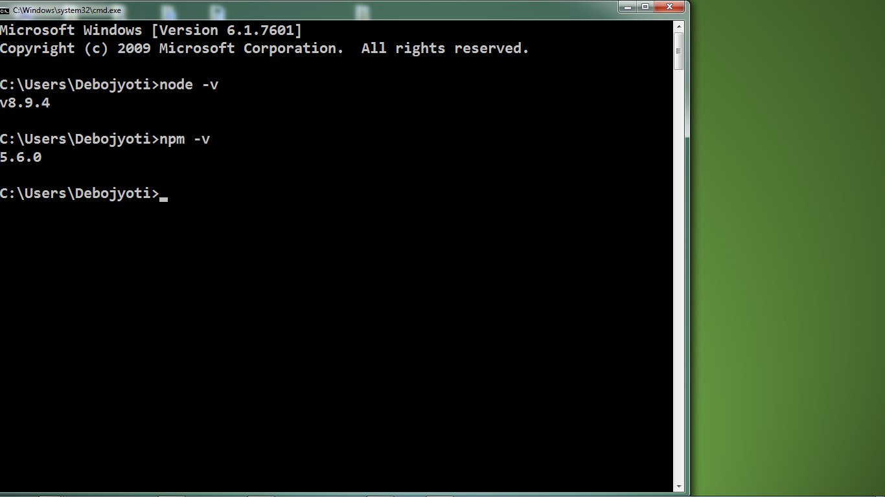
Verify installation status!!
By using Command Prompt window
node - -version or node –v
and
npm - - version or npm –v

Slide 14
Introduction to Node.js Basic Program
Module - 1

Slide 15
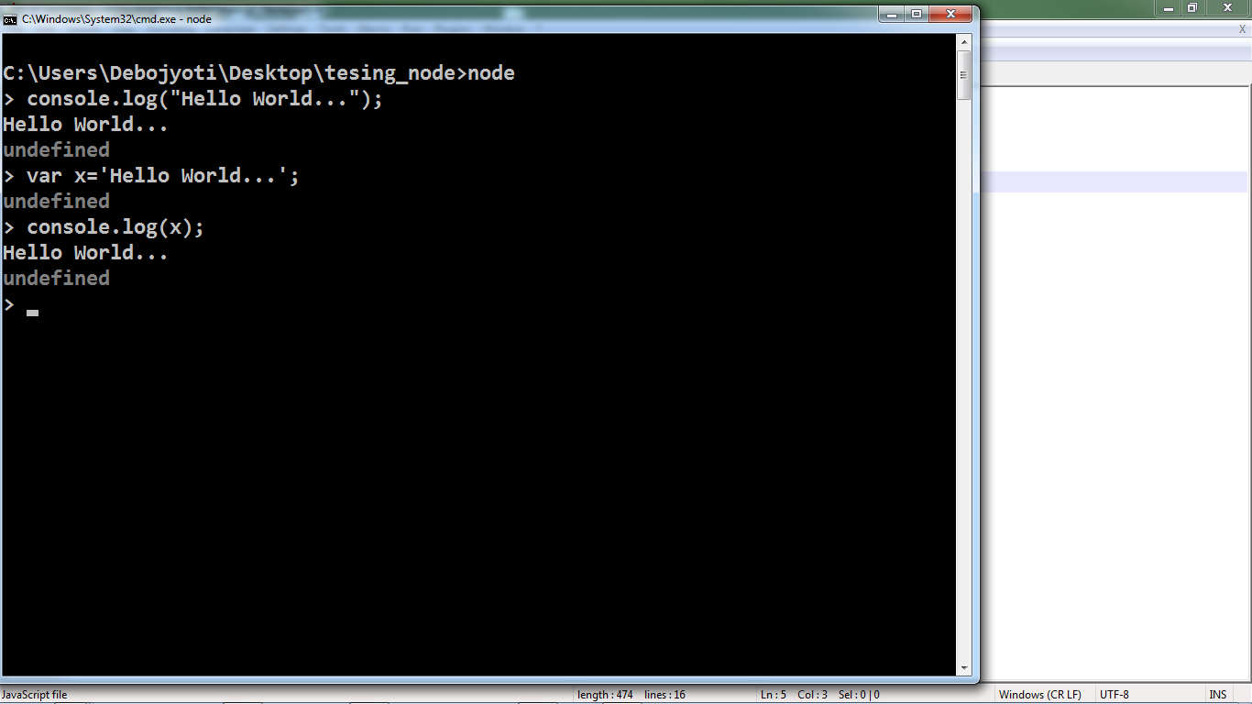
Lets start with “Hello World” Program…

Slide 16
REPL Terminal Example (Read Eval Print Loop)

Slide 17
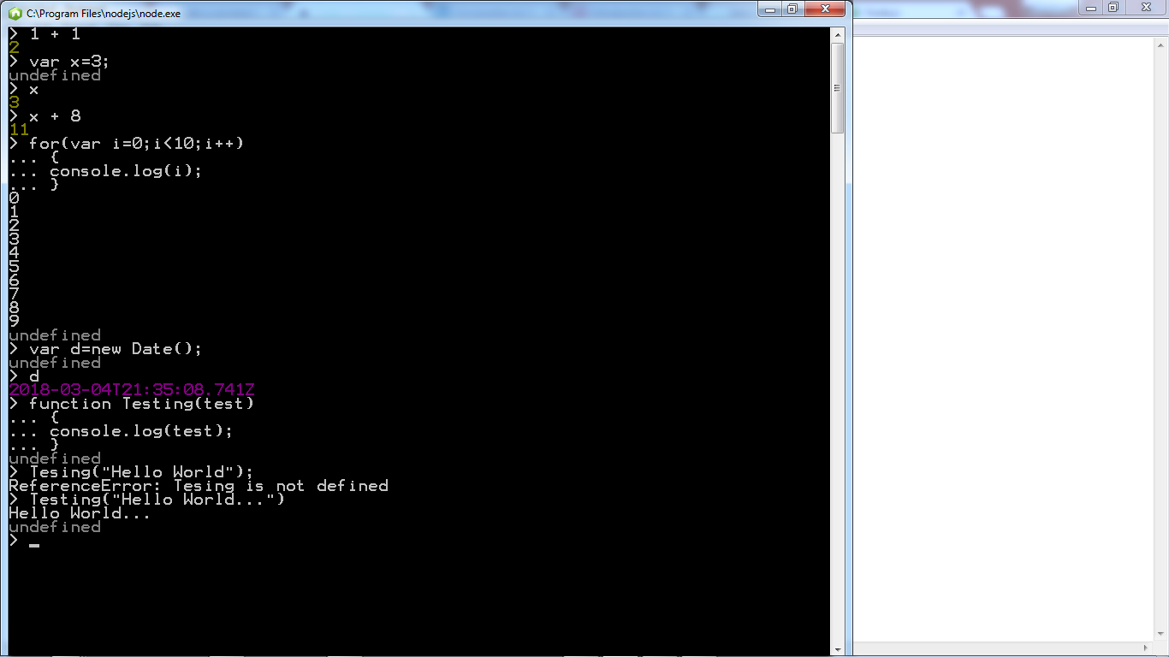

Slide 18
Node.js - First Application

Slide 19
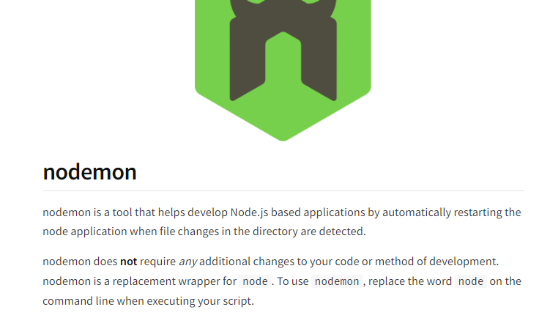
About : nodemon module

Slide 20
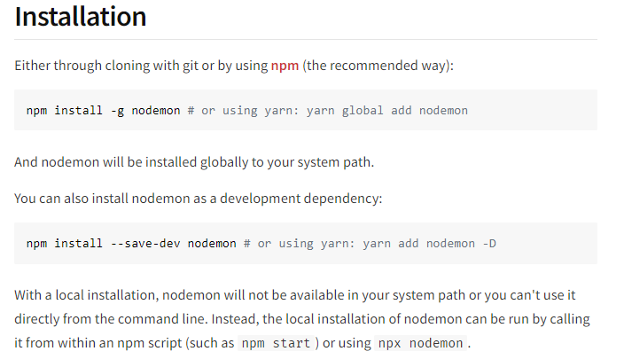

Slide 21
Working with built-in module and some features
http Module
File System ( fs ) Module
Path Module
OS Module
Custom Module
Template String syntax
Arrow function

Slide 22
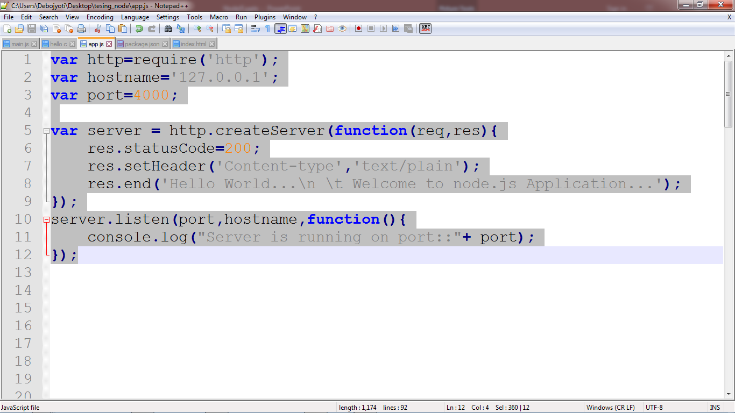
Following code creates an HTTP server and prints ‘Welcome to node.js Application’

Slide 23
About last slide block of code: Components of a NodeJS application
Import required module – We use the require directive to load NodeJS modules.
Create server – A server which responsible to responding client after processing the client request. A server which will listen to client’s requests similar to Apache HTTP Server.
Read request and return response – The server created in an earlier step will read the request made by the client which can be a browser or a console and return the response.

Slide 24
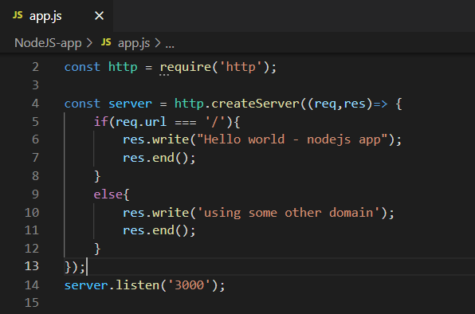
Coding example – http module

Slide 25
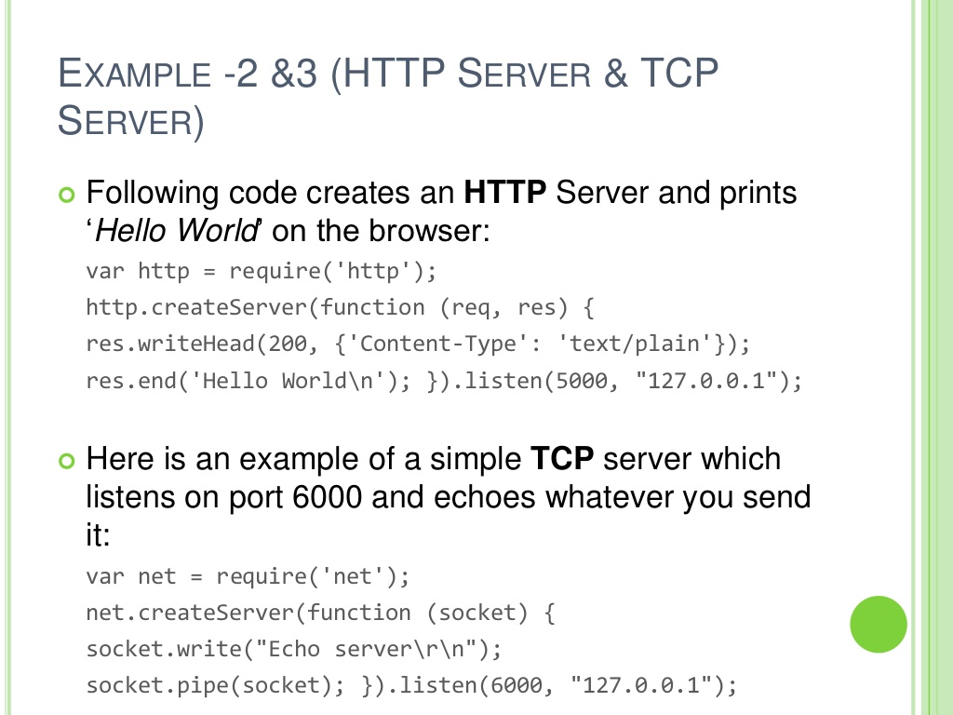

Slide 26
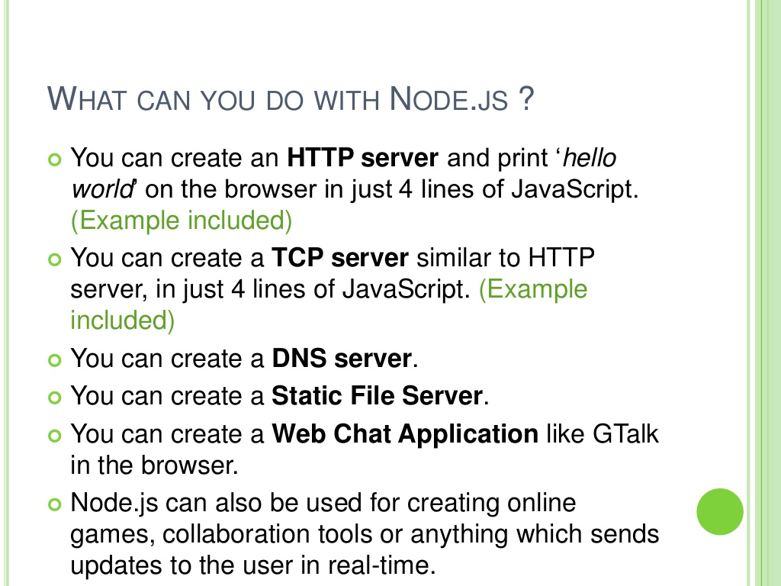

Slide 27
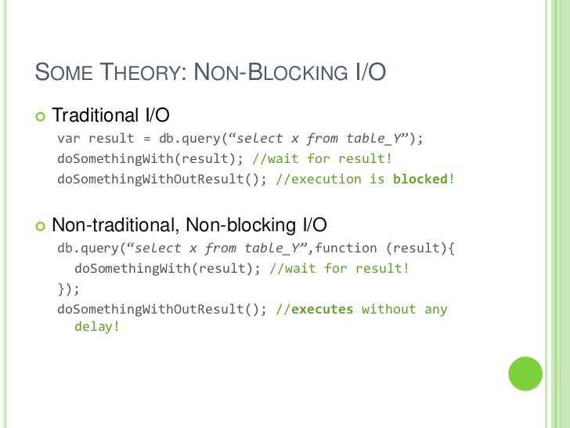

Slide 28
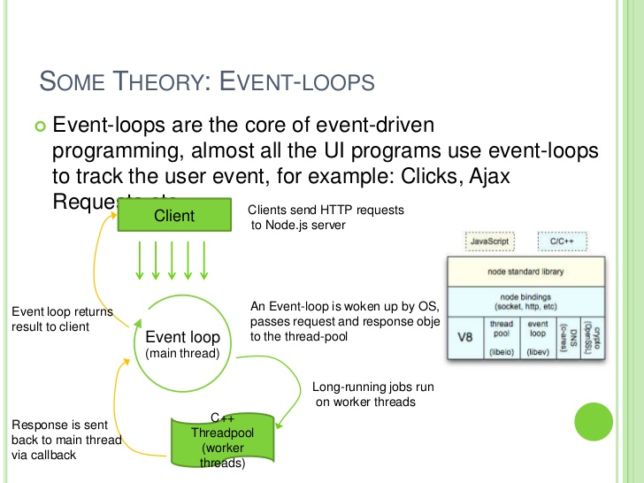

Slide 29
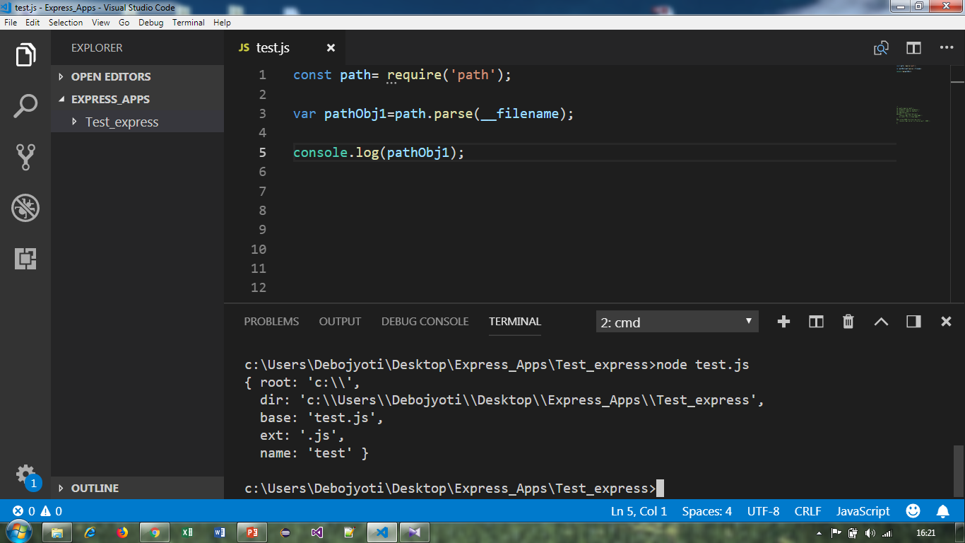
Example-1 : ‘path’ module

Slide 30
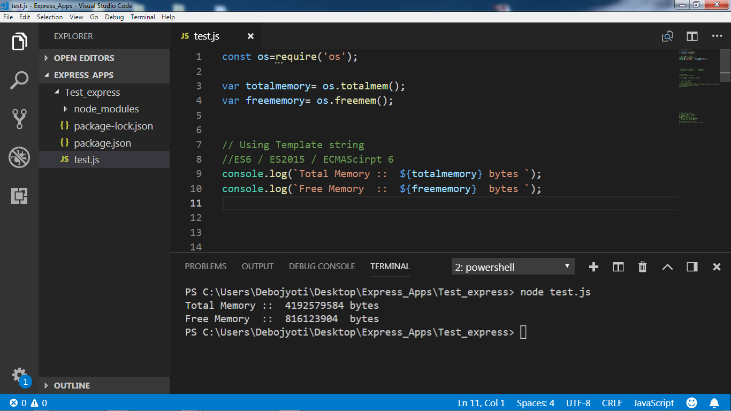
Example-1 : ‘os’ module

Slide 31
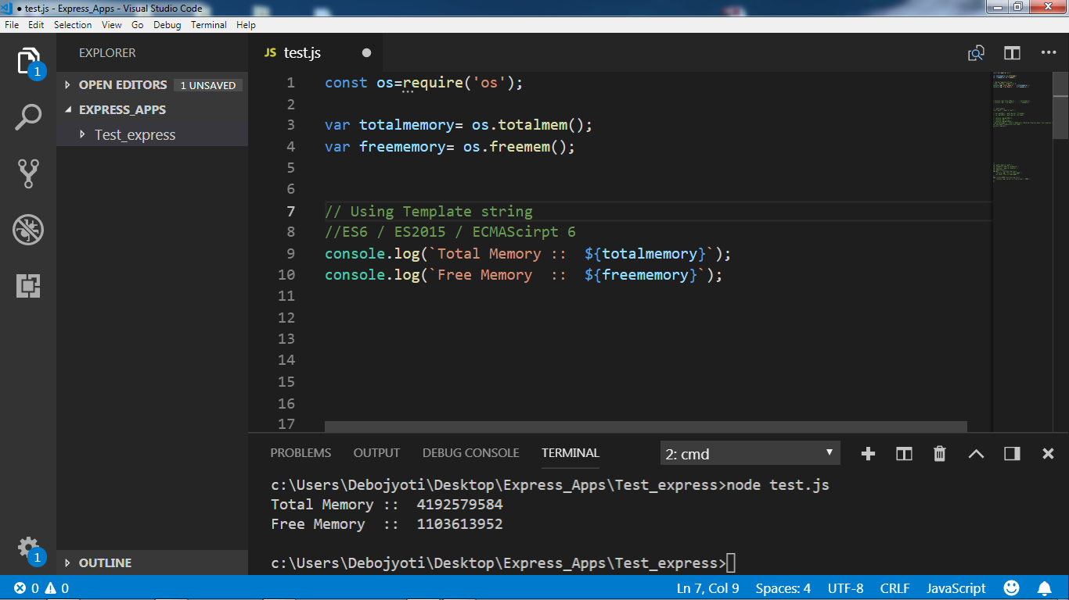
Using ‘Template string’ ES6 feature

Slide 32
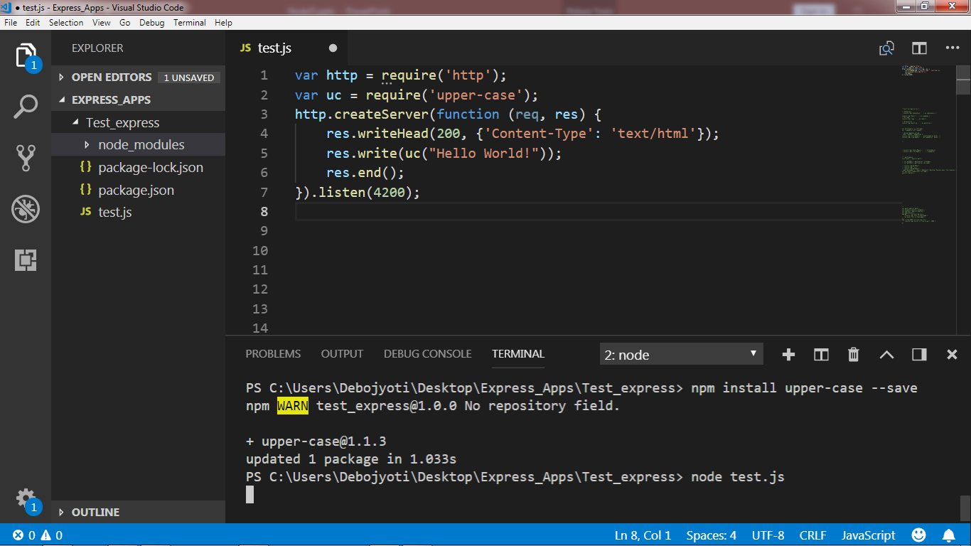
“upper-case” module Example -1

Slide 33
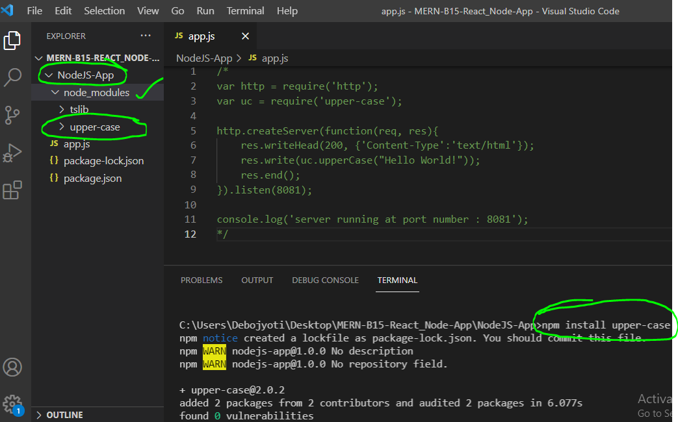
Example : 2 -“upper-case” module Official site for npm - https://www.npmjs.com/

Slide 34
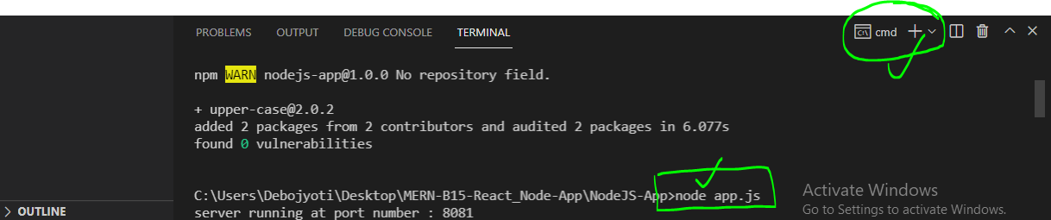
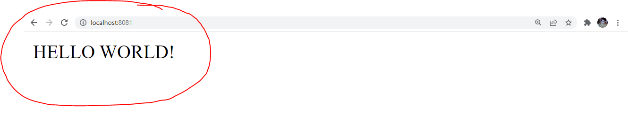
Run && Output

Slide 35
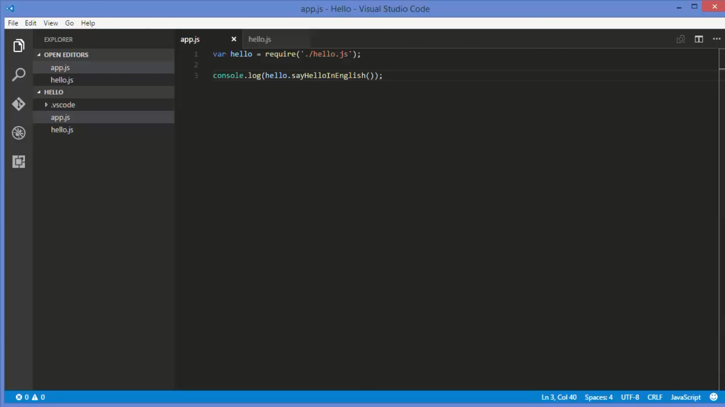
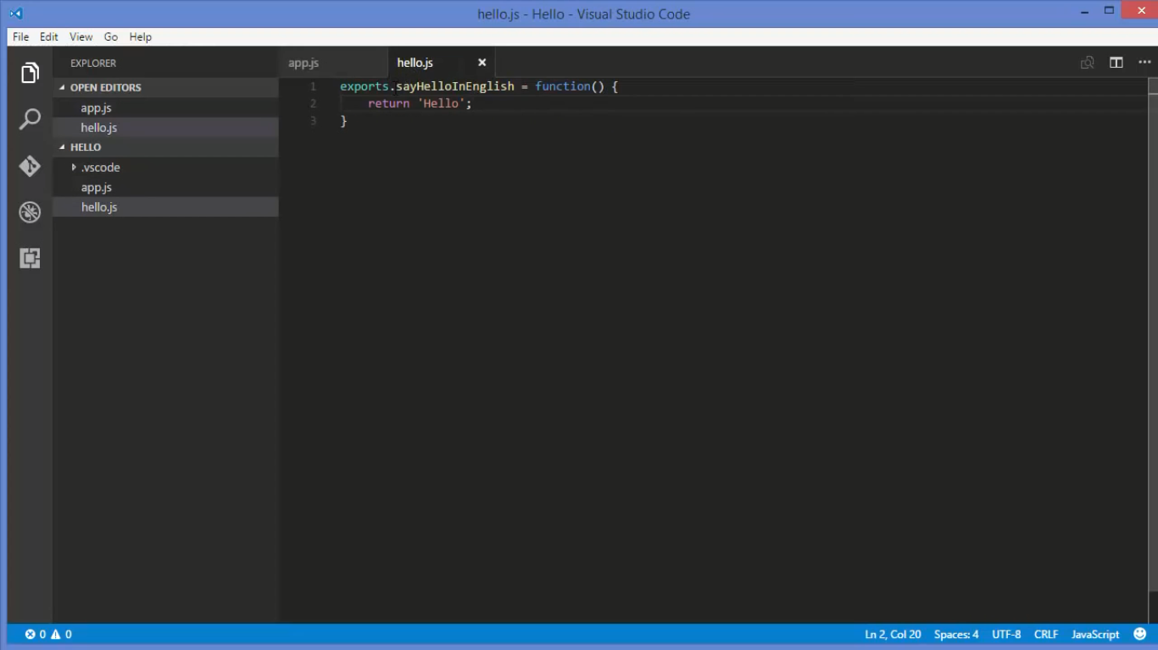
Custom module

Slide 36
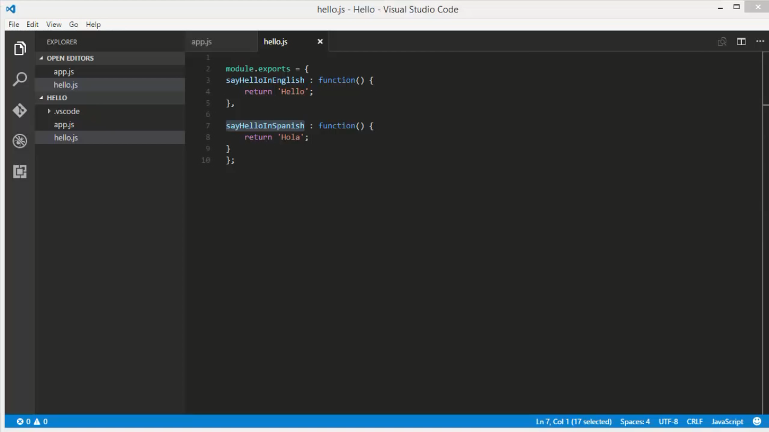
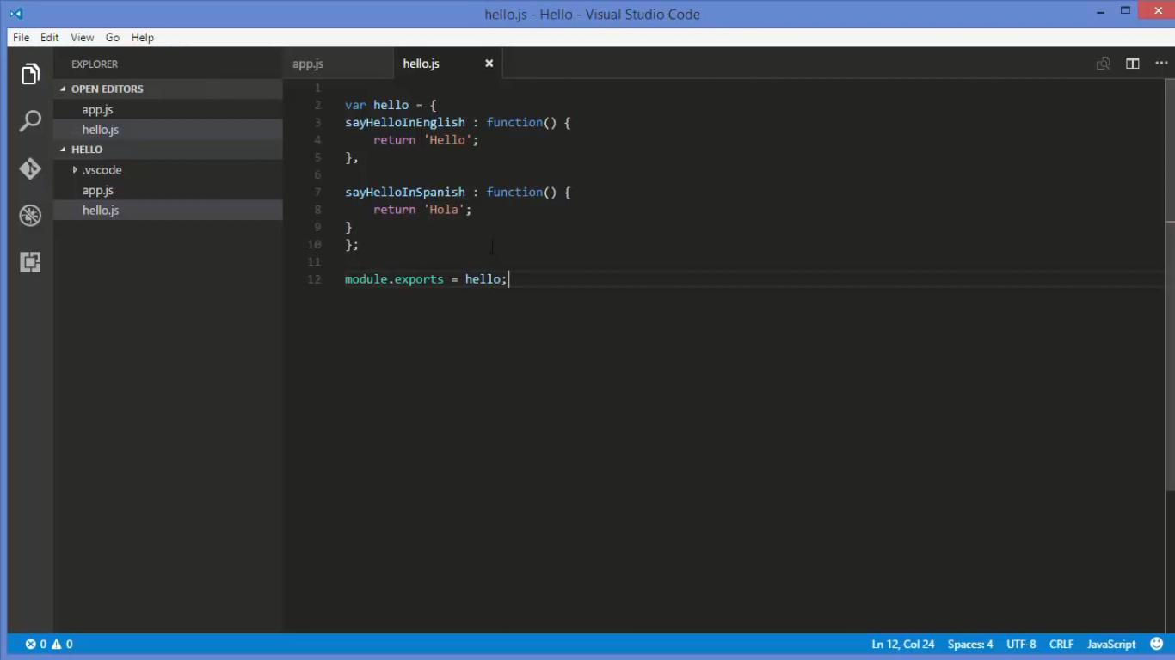
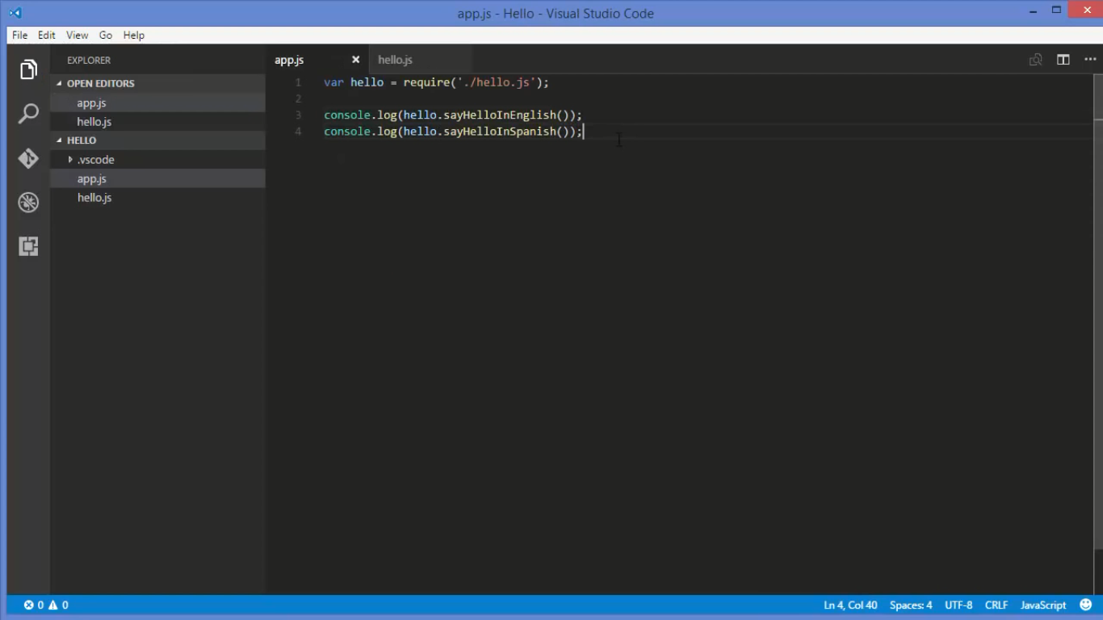
Example 2

Slide 37
Node.js - Global Objects

Slide 38
Some Examples of global object
__filename
__dirname
setTimeout( callback , milliseconds)
clearTimeout(timer)
setInterval(callback, milliseconds)

Slide 39
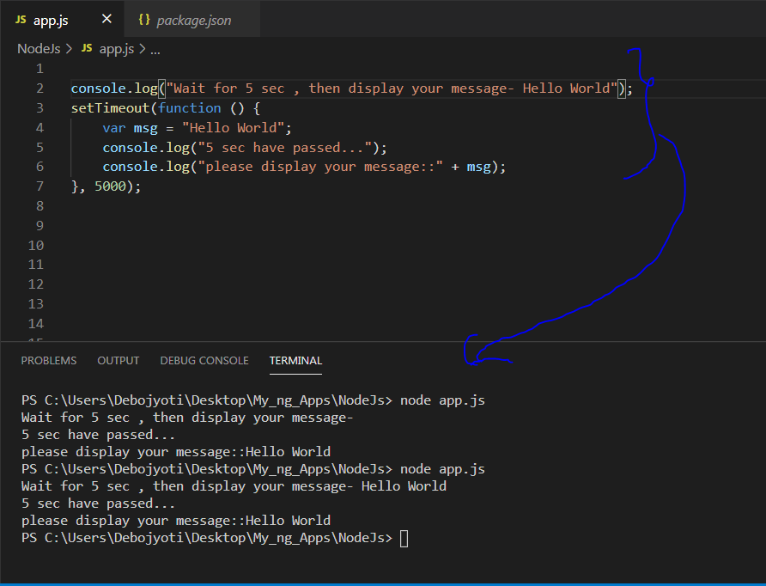
Example -1

Slide 40
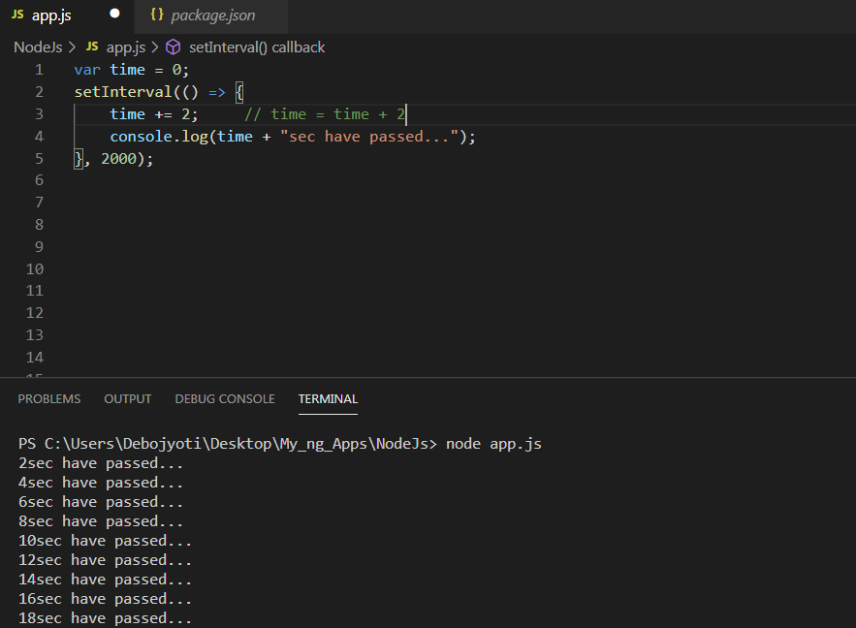
Example -2

Slide 41
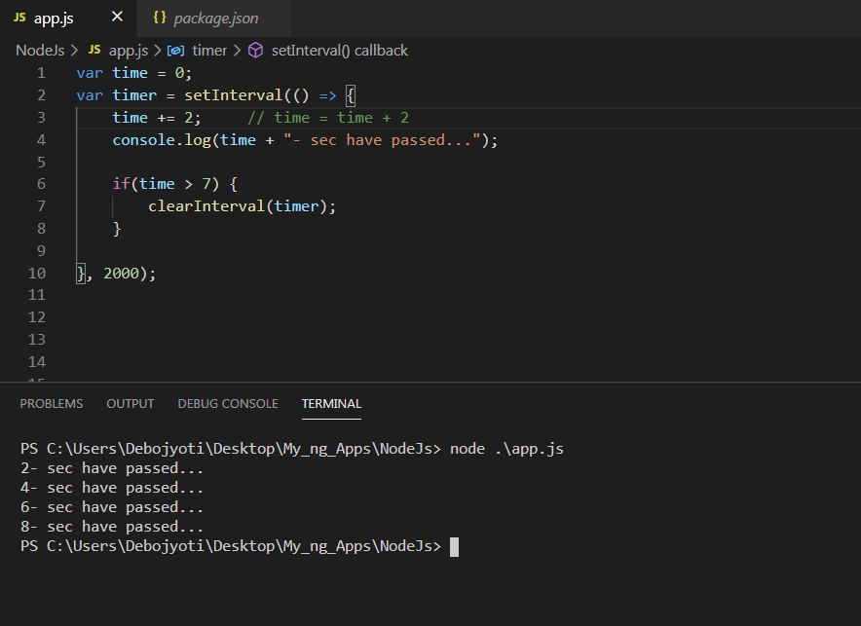
Example -3

Slide 42
Node.js - File System

Slide 43
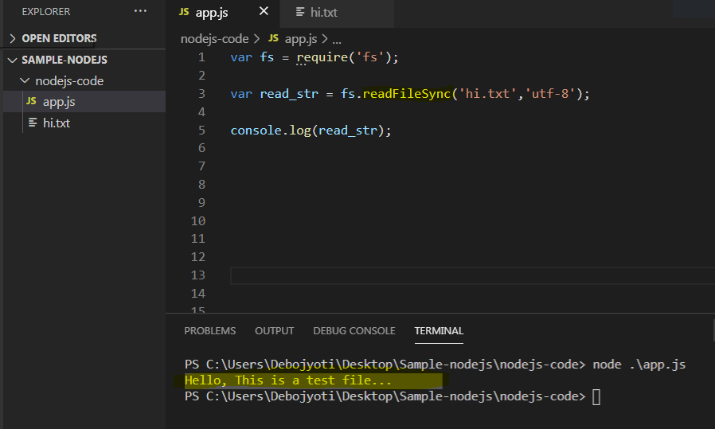
How to read a text (.txt) file!!!

Slide 44
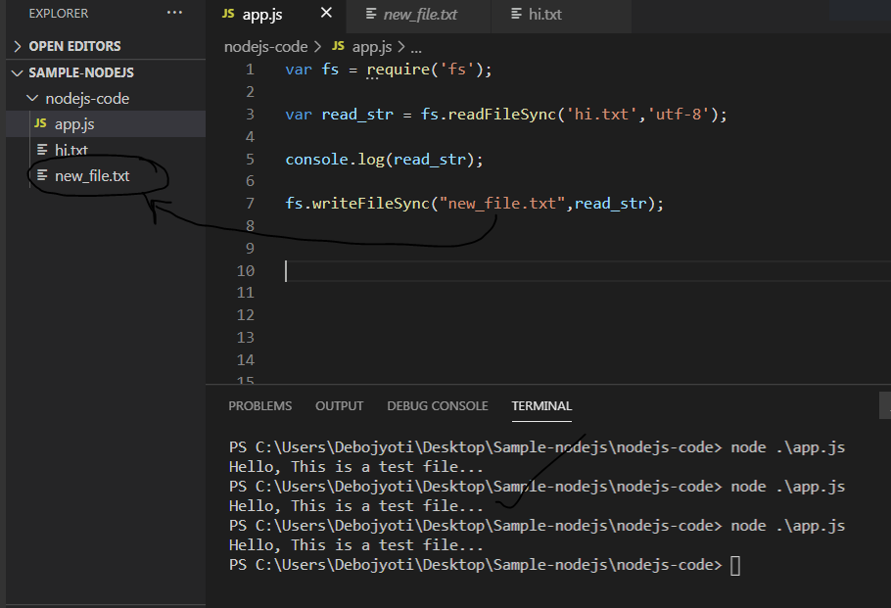
How to write one file content into another file

Slide 45
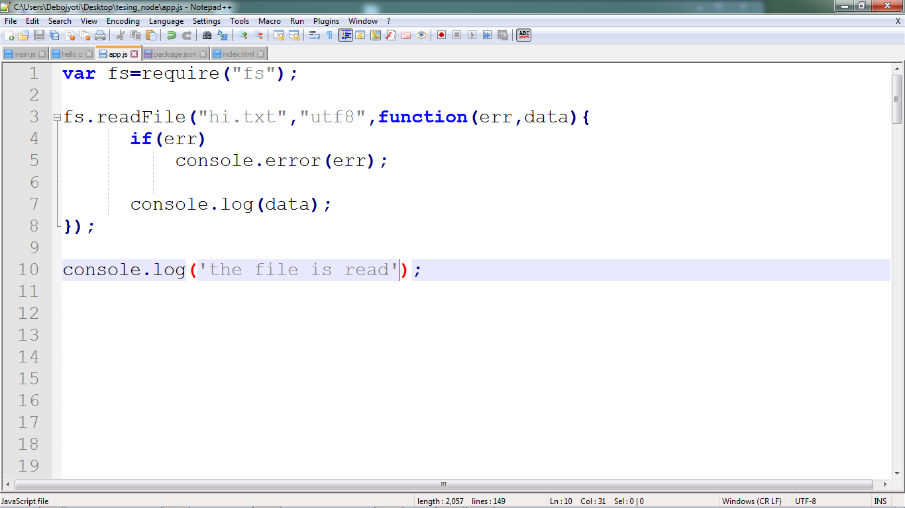
File reading

Slide 46
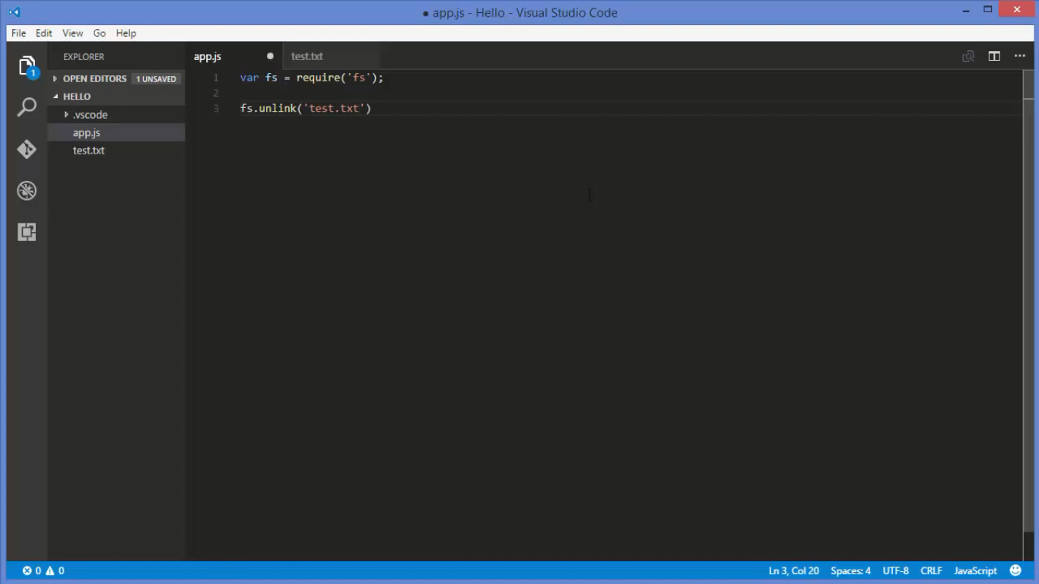
Remove file from dir

Slide 47
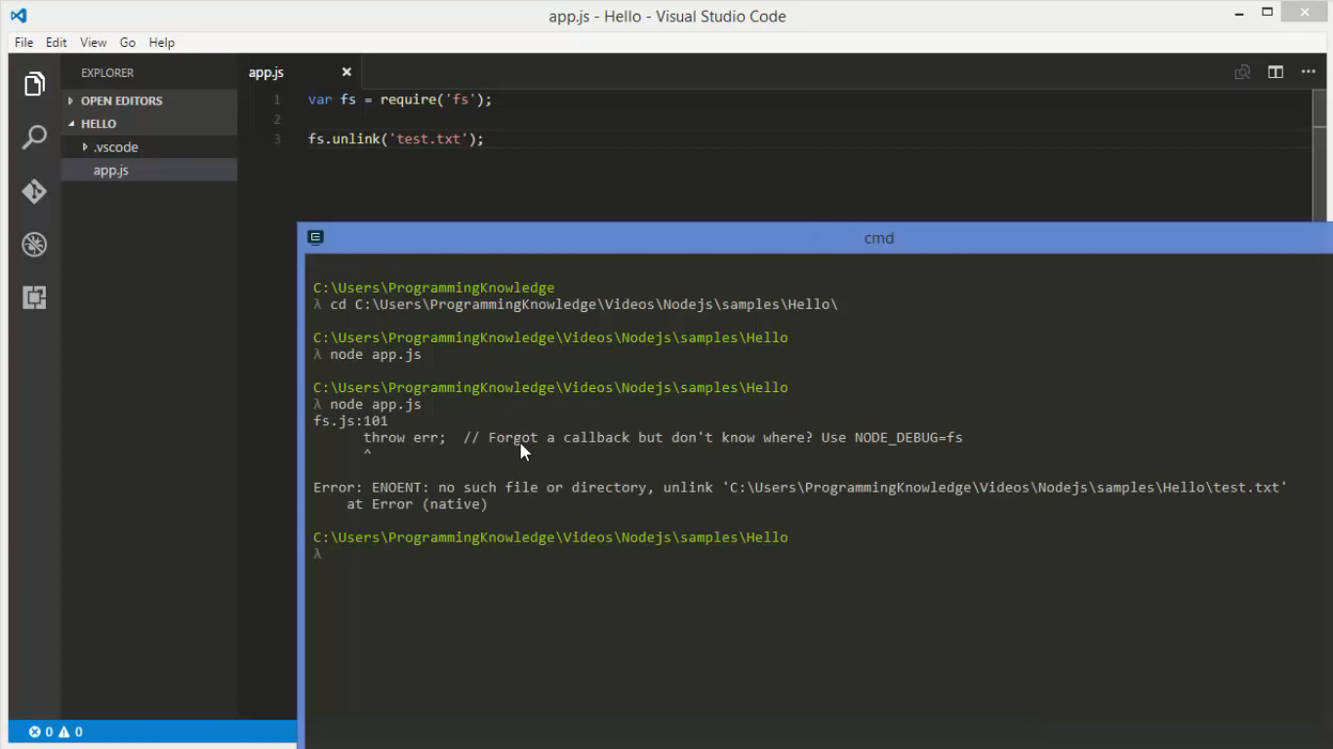
If file is not present=> error

Slide 48
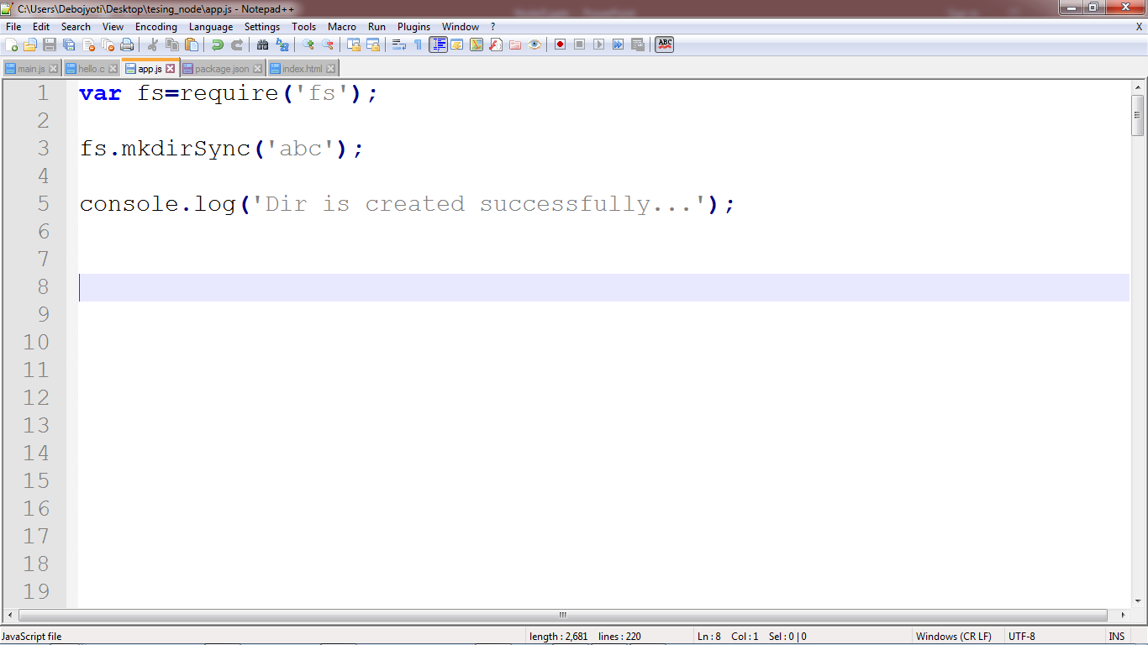
Create dir Sync way

Slide 49
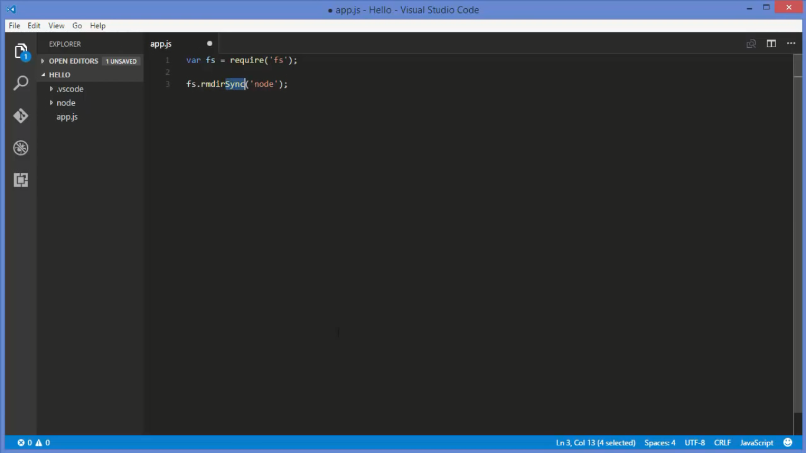
Remove dir Sync way

Slide 50
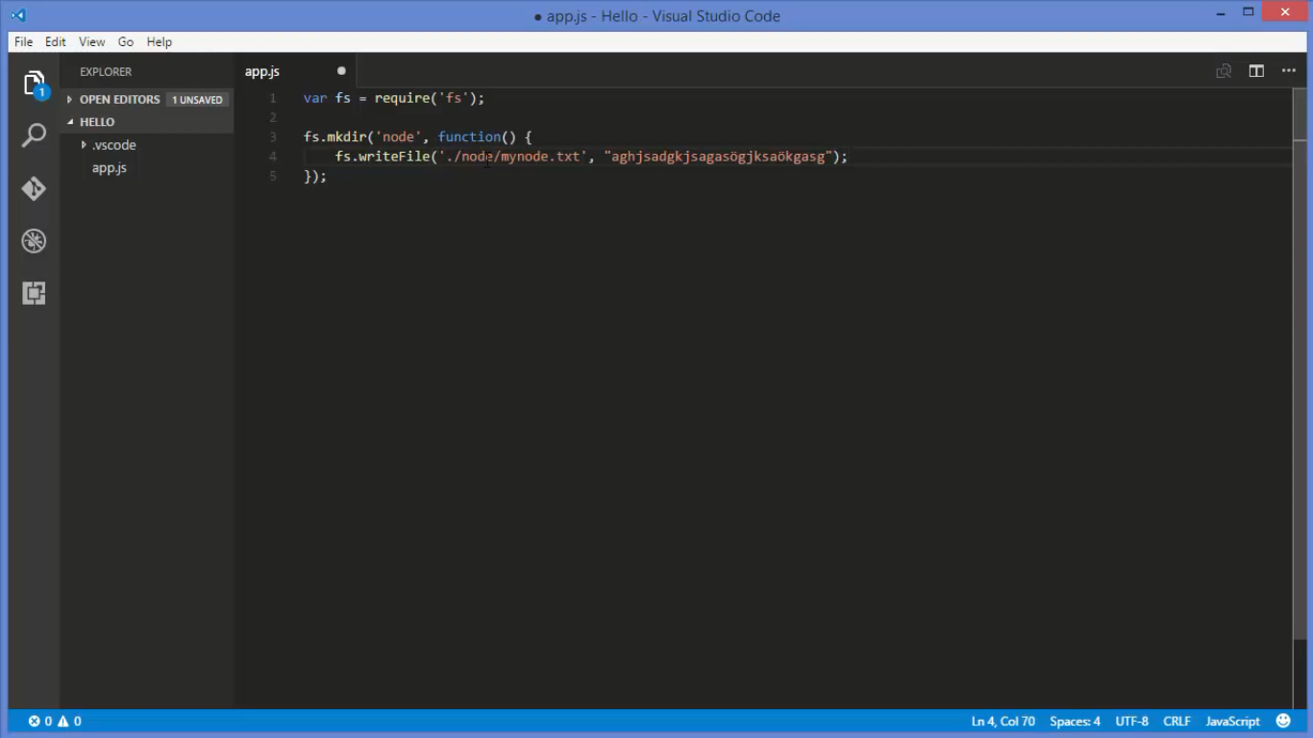
Create dir and file Async way

Slide 51
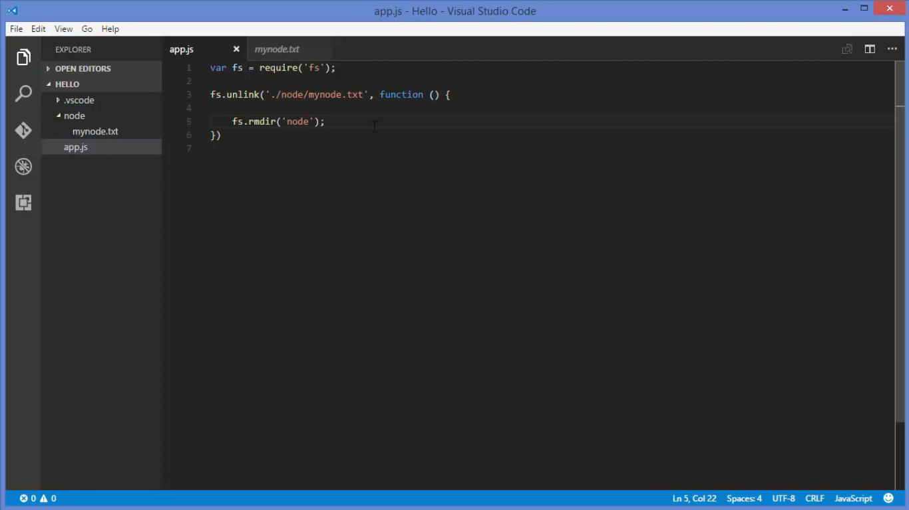
Use of ‘fs’ module

Slide 52
Event Module

Slide 53
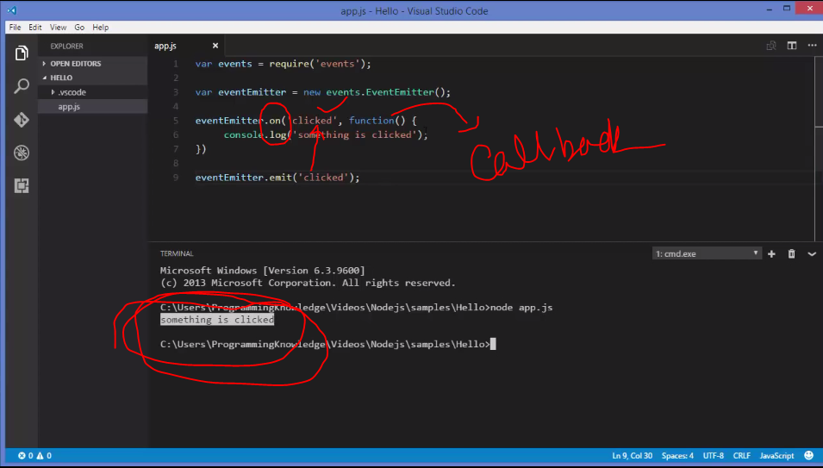
Event Module : Example 1

Slide 54
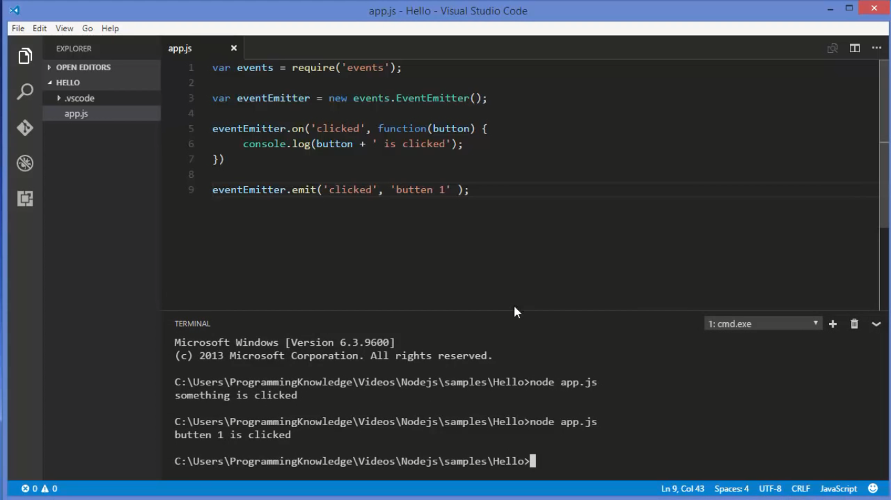
Event Module : Example 2

Slide 55
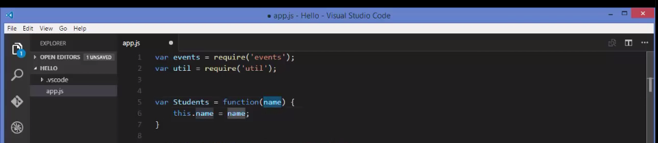
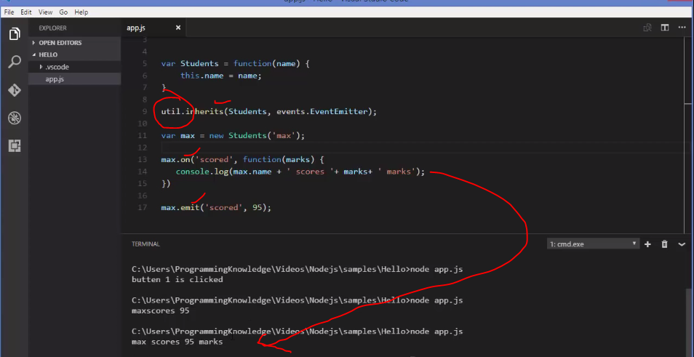
Event (‘util’ module) : Example 2

Slide 56
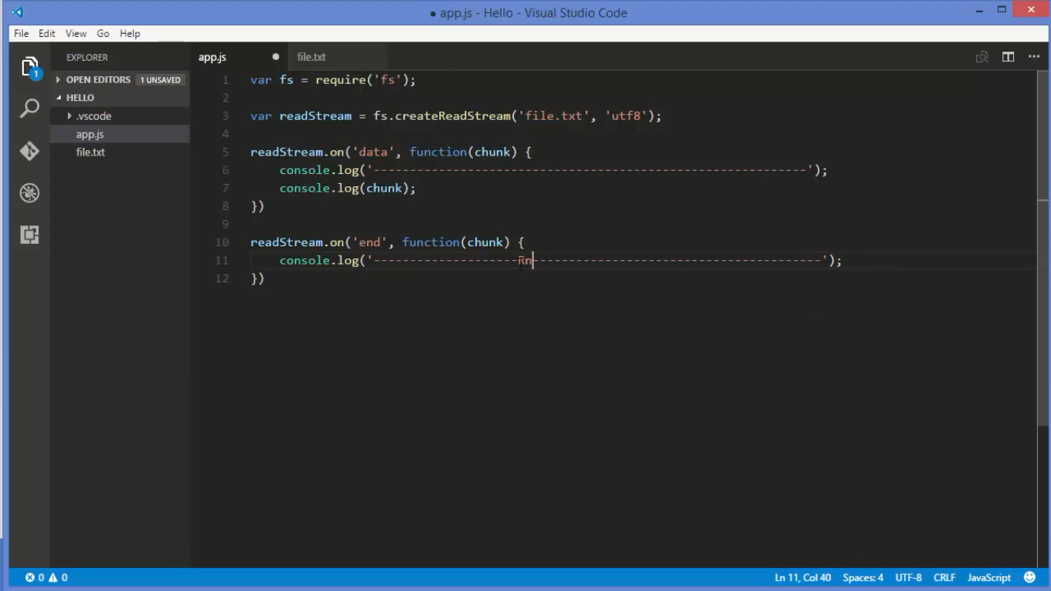
Read File Stream

Slide 57
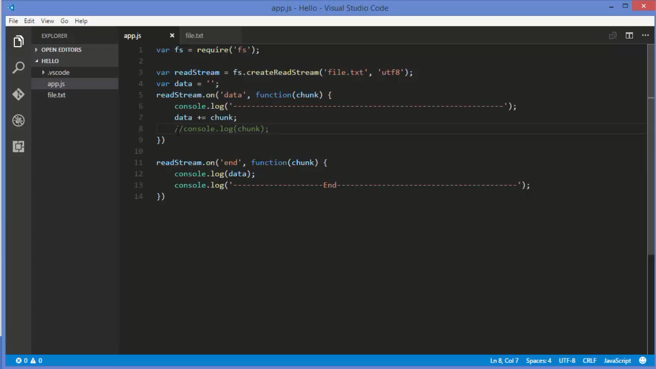
Read File Stream

Slide 58
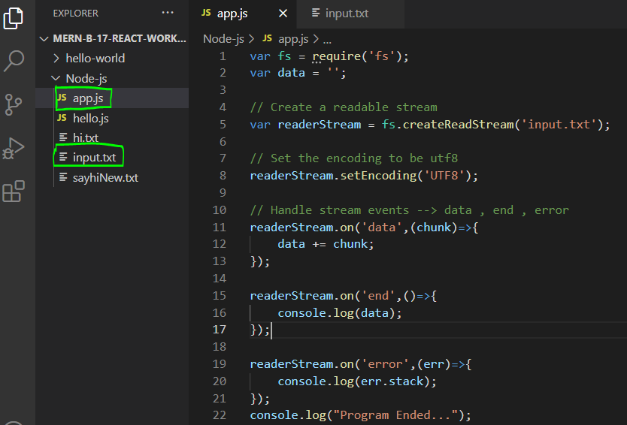
Example - 2

Slide 59
Example-1 (fs module)
var fs=require('fs');
//var readStream=fs.createReadStream('hello.txt','utf8');
var readStream=fs.createReadStream('hello.txt');
readStream.setEncoding('utf8');
var data='';
readStream.on('data',function(md) {
console.log('---------------Start----------------------');
data = data + md; // data += md;
//console.log(md);
});
readStream.on('end',function(md){
console.log(data);
console.log('----------------End-----------------------');
})

Slide 60
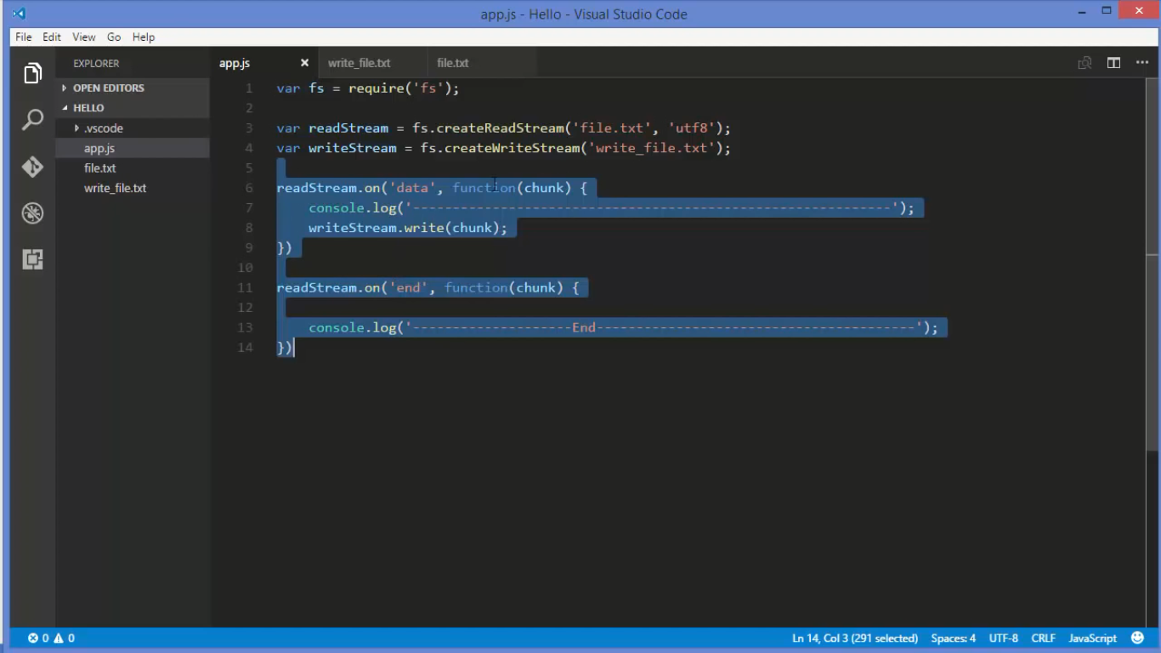
Data flow control using “writeStream” object

Slide 61
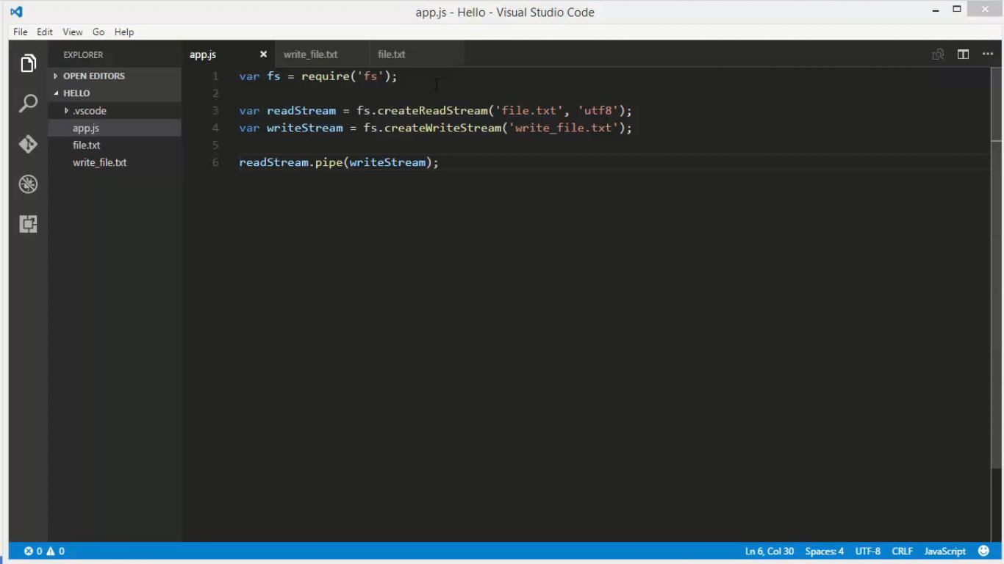
Data flow control using Pipes

Slide 62
Deals with JSON in Node.js

Slide 63
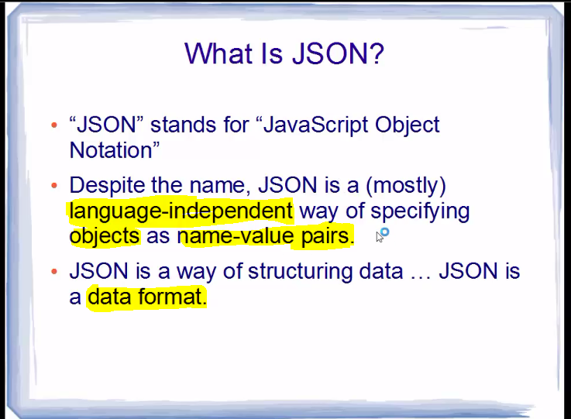
JSON-

Slide 64
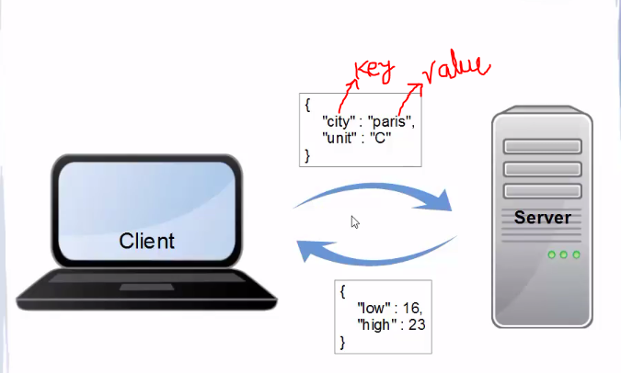
Realtime example of passing JSON DATA

Slide 65

JSON Value JSON- key, value pair. Key– always string format

Slide 66


Slide 67

Passing JSON Data to the Web Browser

Slide 68

Output

Slide 69

Passing JSON Data to the Web Browser Example - 2

Slide 70
Node.js – Routing Concept

Slide 71

Routing Concept using NodeJS app Example-1

Slide 72

Routing Example - 2

Slide 73
Node.js - Express Framework

Slide 74
NodeJS - NPM
Node Package Manager(NPM) Provides two main functionalities –
Online repositories for node.js package/modules which are searchable on search.nodejs.org
Command line utility to install Node.js packages, do version management and dependency management of Node.js packages.
CLI Commands are:
npm --version
Simple syntax to install any Node.js module –
npm install <Module Name>
For Global installation -
npm install express -g

Slide 75

NodeJS NPM

Slide 76

How to install “express”

Slide 77
Use of “-save” flag or command
If you use “-save” flag along with your install command,that will add your package with in package.json file

Slide 78

After uninstall express module:

Slide 79

Next stage (dependencies are still there within package.json

Slide 80

Just using “npm install” command get full express module

Slide 81
Pakage.json file
Whenever you distribute your project.
It contain records about how many new module are being added into your project.
This file is the entry point.
This file is basically a config file for every nodejs project perspective

Slide 82

Use of “ –g “ flag

Slide 83

Working with “ –g” flag
Location or path where global modules are stored.
By using this command we can install it globally.

Slide 84

Introduction to express js

Slide 85

Example 1:express js

Slide 86

How to pass parameters in the url Example -1

Slide 87

Parameters in the url –express_js Example -2

Slide 88


Parameters in the url –express_js Example -3

Slide 89
Node.js - Utility Modules

Slide 90

Some important topics

Slide 91

Continue…

Slide 92
MongoDB

Slide 93
Download link – required S/W
Mongodb-download
https://www.mongodb.com/download-center/community
Mongodb- compass
https://www.mongodb.com/download-center/compass?jmp=hero
Postman app::
https://www.getpostman.com/apps
NPM Official Site
https://www.npmjs.com/

Slide 94
Some of the popular Application using node.js
Yahoo!
Linkedin
eBay

